Slide 1
Detection, Segmentation and Classification of
Breast Ultrasound Images
Group 5 Sohyun Shin, Yujeong Yang, Xinyu Zhang

Slide 2
Agenda
01. Introduction to breast cancer screening
02. Datasets: breast ultrasound images
03. Goals & Questions to solve
04. Methodology
05. Current Status & Findings
06. Reflection & Learning

Slide 3
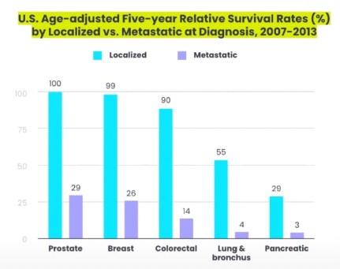
Introduction
Early detection makes an impact.
  Cancer screening: detect cancer or pre-cancerous conditions at asymptomatic stage.
  Increased survival rate when detect cancer early.

Slide 4
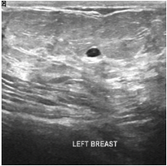
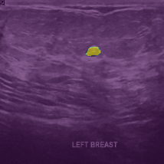
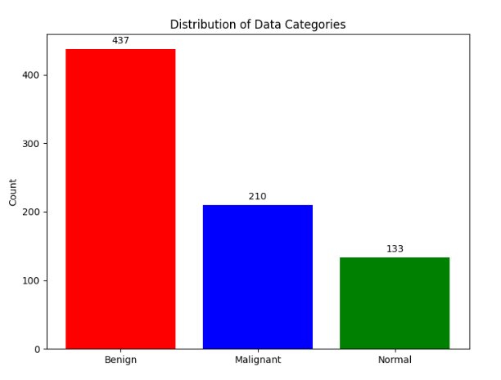
Datasets
780 Images from 600 patients (age 25~75)
PNG format with size of 500*500 pixels
Categorized into 3 classes:
Normal (133)
Benign (437)
Malignant (210)
* Al-Dhabyani W, Gomaa M, Khaled H, Fahmy A. Dataset of breast ultrasound images. Data in Brief. 2020
Feb;28:104863. DOI: 10.1016/j.dib.2019.104863.

Slide 5
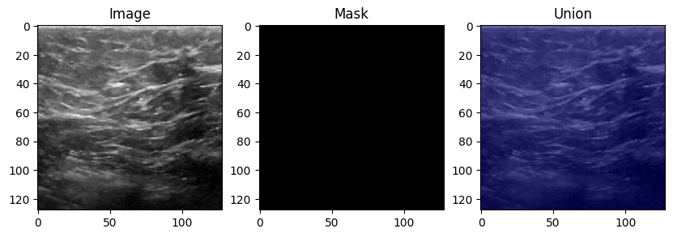
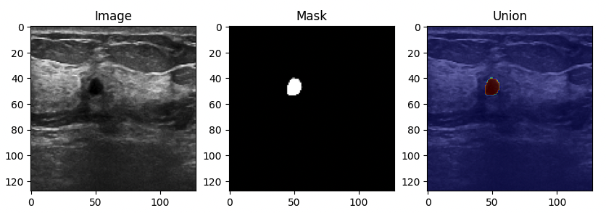
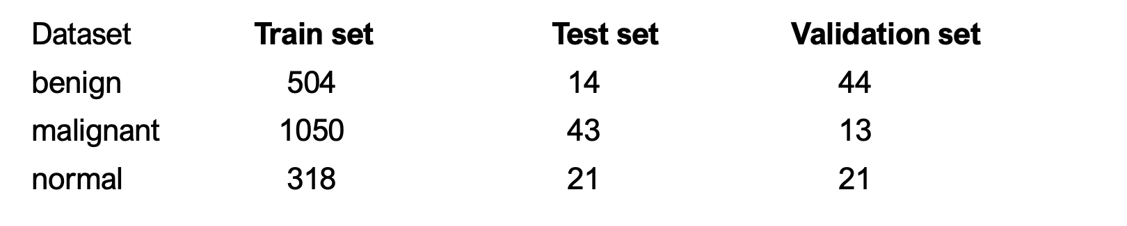
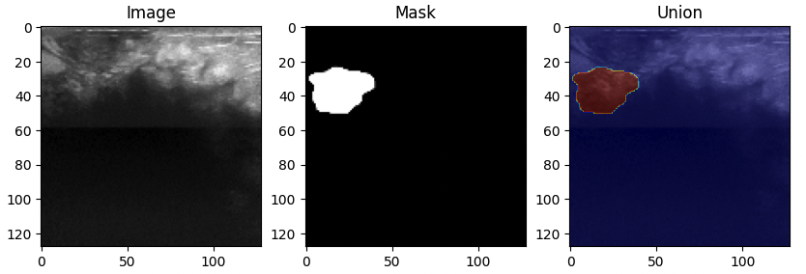
Normal
Benign
Malignant
* Al-Dhabyani W, Gomaa M, Khaled H, Fahmy A. Dataset of breast ultrasound images. Data in Brief. 2020
Feb;28:104863. DOI: 10.1016/j.dib.2019.104863.

Slide 6
Goals
Find the best model to:
Detect abnormal lesions from ultrasound images
Classify types of the abnormal lesions (Normal, benign, malignant)
3 Questions to reach the goals:
Q1. Does introducing segmentation model lead to better performance than
detection model in classification of legions?
Q2. Which type of segmentation model performs better?
(If segmentation performs better than detection)
Q3. Does transformer-based segmentation approach show good performance?

Slide 7
Questions to solve
Better in classification?
: Detection vs. Segmentation
Which segmentation
performs better?
Transformer-based
Segmentation performance?
Detection model
: Faster R-CNN
Segmentation models
: Mask R-CNN, U-Net, MedSAM
Add extra neural network
to classify type of legion
Evaluate and Compare
: Precision, Recall, F1 Score
3 different models
: Mask R-CNN,
U-Net and MedSAM
Evaluate and Compare
: Intersection over Union (IoU)
MedSAM
Compare with 2 other
segmentation models
Find out if transformer
also works well on images

Slide 8
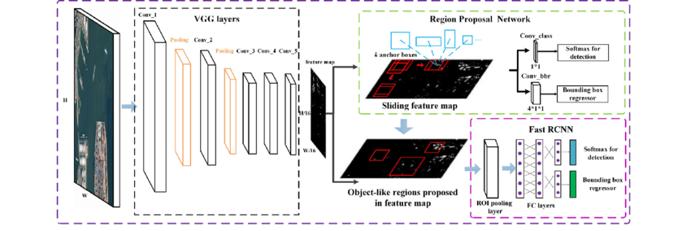
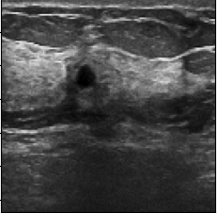
Methodology – Faster R-CNN
Dataset Preparation:
  Data augmentation
  Annotation: Label images with bounding boxes around lesions and classify each as benign or malignant.
Faster R-CNN:
  Combines Region Proposal Networks (RPN) with Convolutional Neural Networks (CNN).
Detection: Model proposes regions of interest (ROIs) potentially containing lesions.
Classification: Each detected lesion is classified as benign or malignant.
Evaluation: precision, recall and F-1 score

Slide 9
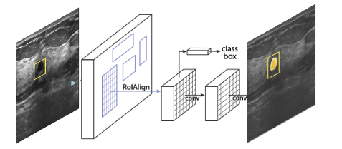
Methodology – Mask R-CNN
Dataset Preparation:
  Data augmentation
  Annotation: Label images with bounding and segmentation mask
Mask R-CNN:
  Extends Faster R-CNN by adding a segmentation mask predictor.
Segmentation: Model identifies regions of interest and generates precise segmentation masks.
Classification: Each detected lesion is classified as normal, benign or malignant.
Evaluation: IoU, precision, recall and F-1 score
Notes:
first identify regions of interest (RoIs) in the ultrasound images. For each RoI, the model will create a segmentation mask, effectively outlining the shape of the lesion or region being examined.

Slide 10
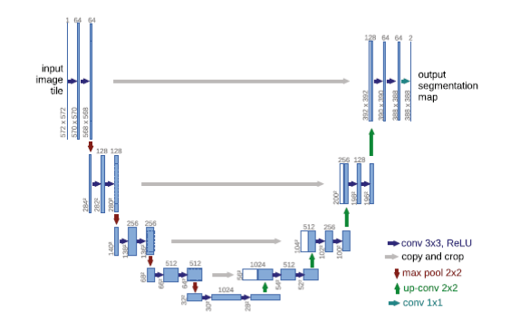
Methodology – U-Net
U-Net:
  Implemented original architecture of layers, with BCE loss function(optimizer=Adam, learning rate=0.01)
  Current learning status : epoch (1/10), average loss (0.00), average IoU (0.00)
Segmentation: Model predicts classes of each pixel and generates segmentation masks.
Classification: Additional classifier to classify the whole image as normal, benign or malignant.
  Due to its contracting path, might not perform very well with small legion
(Will compare with Mask R-CNN)
Evaluation: IoU(itself), precision, recall and F-1 score(after additional classifier)
Notes:
first identify regions of interest (RoIs) in the ultrasound images. For each RoI, the model will create a segmentation mask, effectively outlining the shape of the lesion or region being examined.

Slide 11
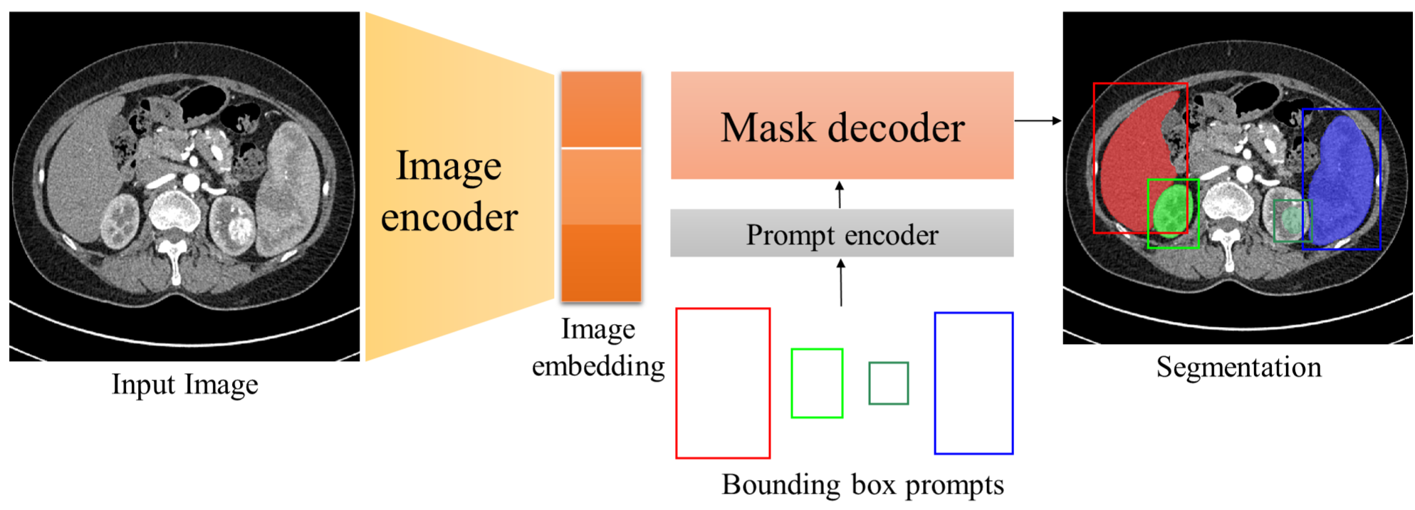
Methodology - MedSAM
the precision in classifying the nature of identified objects.
MedSAM (Vision transformer for medical images)
Segment Anything specially trained on a vast dataset of over a million medical image-mask pairs
Pre-trained vision transformer - foundation model for image segmentation
Three layers:
  Image encoder / Prompt decoder /Mask decoder
Can be fine-tuned model with data set
Notes:
the precision in classifying the nature of identified objects.

Slide 12
Methodology
the precision in classifying the nature of identified objects.
U-Net (Segmentation for biomedical images)
Segment legions using its convolution-deconvolution architecture
Due to its contracting path, might not perform very well in image with small legion
(Will compare with Mask R-CNN)
MedSAM (Vision transformer for medical images)
SAM specially trained on a vast dataset of over a million medical image-mask pairs
1) Segment legions, 2) further differentiate benign and malignant lesions
Neural Network Classification
To classify type of (detected and segmented) legions, we will add a classifier
⇒ Then, evaluate the precision of each model in classifying legions!
Notes:
the precision in classifying the nature of identified objects.

Slide 13
Current Status & Findings
the precision in classifying the nature of identified objects.
U-Net
Initial findings show that it takes a very long time to train
IoU observed so far does not seem promising
MedSAM (Vision transformer for medical images)
Encountering CUDA out of memory error when fine-tuning the model
using batch size =1 and Google Colab Pro
Rigid data requirements that it can only have 1024 x 1024 image as an input
Notes:
the precision in classifying the nature of identified objects.

Slide 14
Reflection and Future Plan
the precision in classifying the nature of identified objects.
Complex models are not always better
We are experiencing first-hand that complex segmentation models are difficult to implement when they do not guarantee meaningfully better performance
If the complex models were less computationally expensive, it could be a great tool to track precise changes in lumps. If it’s just for assisting diagnosis, a simple detection model might be enough
Medical images are harder to work with
Since medical images are usually in gray scale (1 channel), it seems though it might be less information than other types of images which have 3 channels (rgb)
Future Plan
Notes:
the precision in classifying the nature of identified objects.

